Slide 1
AI in Science Fiction

Slide 2
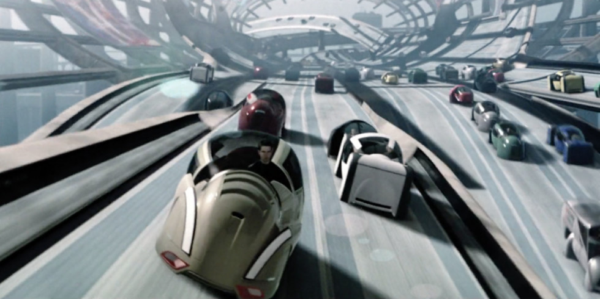
Self-driving cars

Slide 3
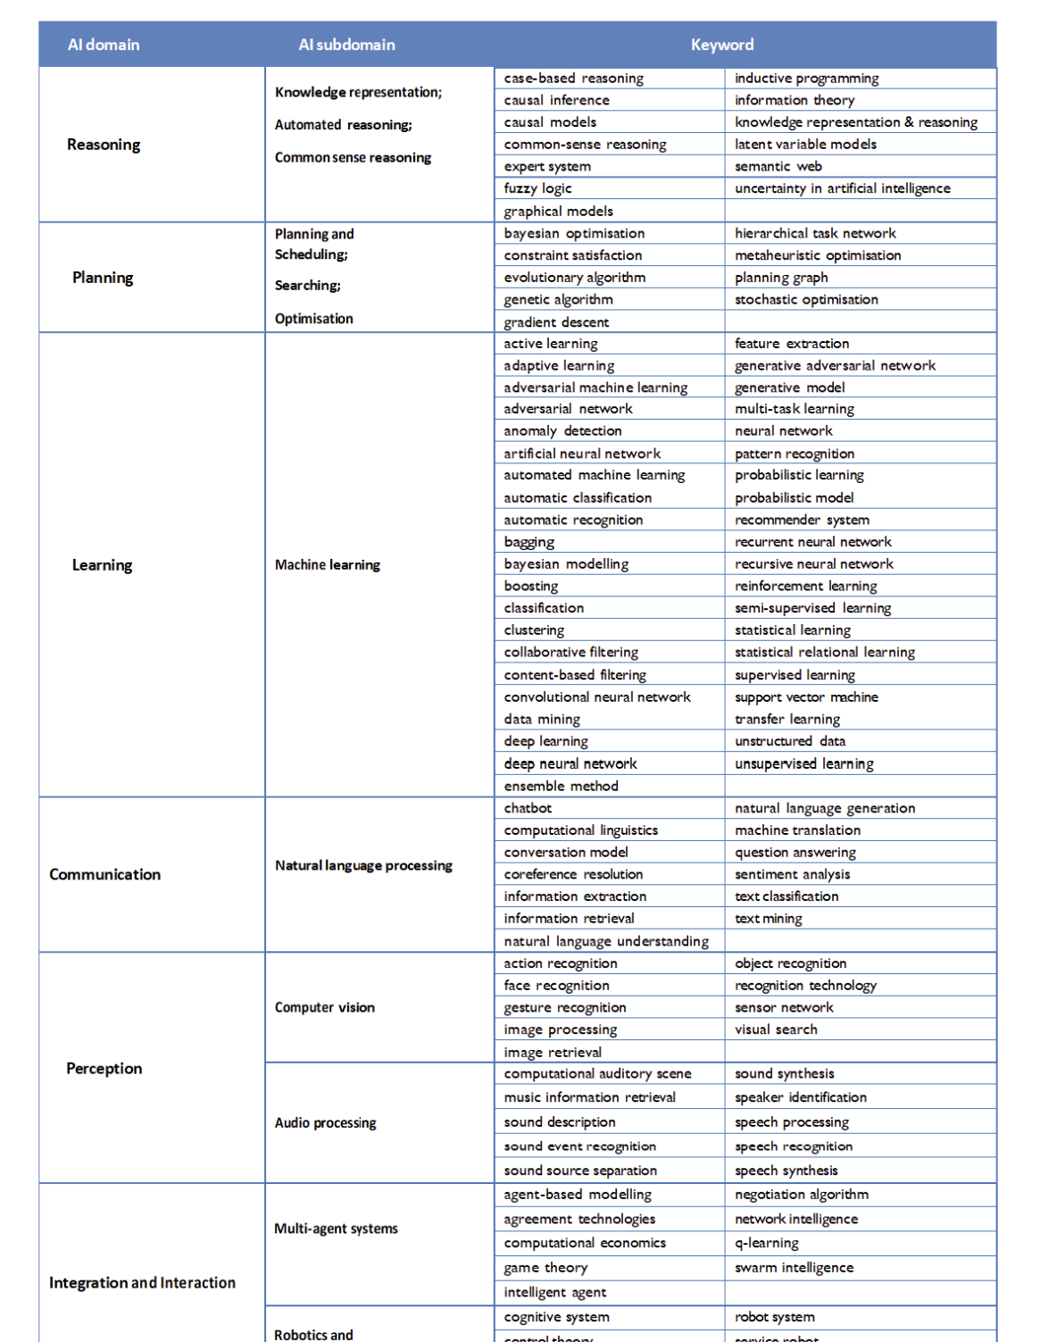
Taxonomy of AI
Perception
Computer vision
Integration and Interaction
Connected and Automated vehicles
Robotics and Automation
Notes:
Computer vision: Advanced object recognition, image processing, and sensor networks.
Connected and automated vehicles: Operate independently without human intervention
Robotics and automation: Incorporate elements like control theory and cognitive systems to understand their environment. Integration of human-AI interaction for emergency overrides or manual control.
Control theory - Control theory is the study of how agents can best interact with their environment to achieve a desired goal. The goal of control theory is to design algorithms that enable agents to make optimal decisions, while taking into account the uncertainty of the environment.
Cognitive systems - These systems possess human-like intelligence and can emulate the way a human brain works.

Slide 4
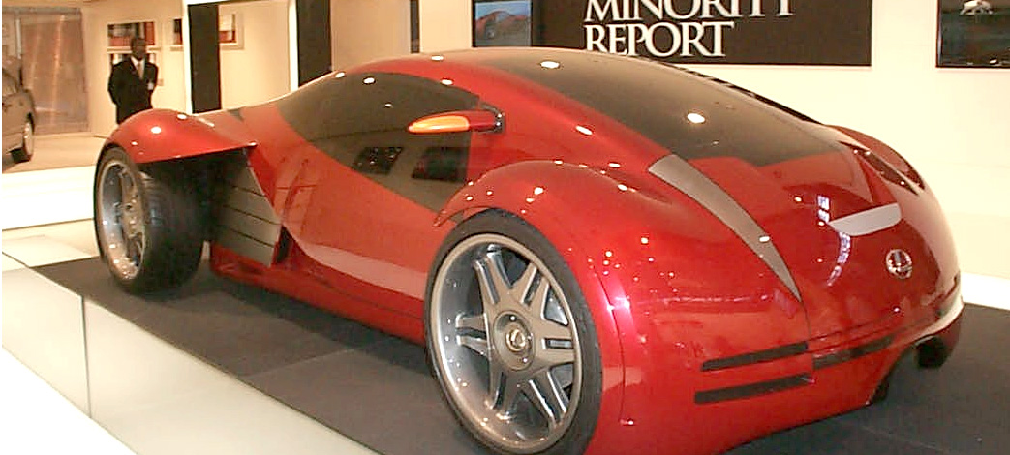
Are these cars currently possible?

Slide 5

Why not?
Humans
“building safe driverless cars is harder than rocket science”
Waymo CEO
Notes:
American Society of Automotive Engineers
Waymo

Slide 6
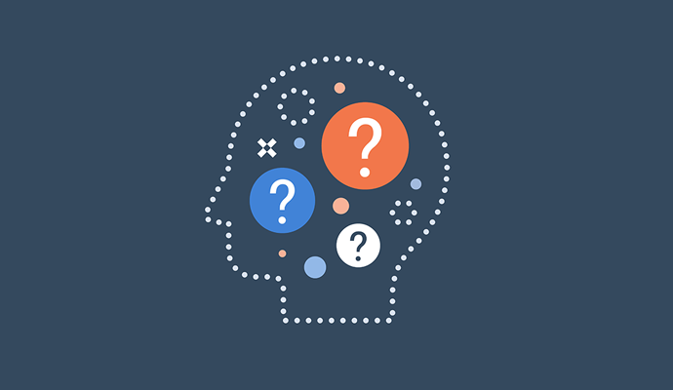
Ethical implications
Who should be held responsible?

Slide 7
References
Jon Kelvey (March 9, 2024). Minority Report’s Greatest Prediction Isn’t the One You Think: https://www.inverse.com/science/minority-report-driverless-cars-real-science
Kamila Rzymska (October 25, 2021). How ‘Minority Report’ Predicted the Future of Automotive and
The Emergence of Self-driving Cars
https://www.comarch.com/telecommunications/blog/how-minority-report-predicted-the-future-of-automotive/
Naveen Joshi (Augustus 5, 2022). 5 Moral Dilemmas That Self-Driving Cars Face Today: https://www.forbes.com/sites/naveenjoshi/2022/08/05/5-moral-dilemmas-that-self-driving-cars-face-today/

